Slide 1

Python
Object Oriented Programming

Slide 2

Object Oriented Concepts
• Encapsulation
• Inheritance
• Polymorphism
• Overloading
• Overriding
www.skillslash.com

Slide 3
Creating Class
Syntax:
Class ClassName: 'Optional class documentation string' class_suite
The class has a documentation string, which can be accessed viaClassName.__doc__.
The class_suite consists of all the component statements defining class members, data attributes and functions.
www.skillslash.com

Slide 4
Introduction
Till now we created programs using functions i.e. is a procedure oriented.
Other way combine data and functions, wrap them and add them in a object. i.e. Object Oriented Programming.
Class creates a new type. Object is an instance of the class.
E.g Student Class. Object?
Shape class
www.skillslash.com

Slide 5
Terms
• Fields: Variables that belong to the class.
• Methods: Does some operation in the class.
• Attributes: Fields and Methods.
• Instance Variables: Variables of the class.
www.skillslash.com

Slide 6
Class Creation
Class Person:
pass #An Empty Block
p = Person()
print(p)
# This file name is oop_simplestclass.py
Output:
$ python oop_simplestclass.py
www.skillslash.com

Slide 7
Self function
• class A(object):
def __init__(self): self.x = 'Hello'
def method_a(self, foo):
print self.x + ' ' + foo
• The self variable represents the instance of the object itself. Most object-oriented languages pass this as a hidden parameter to the methods defined on an object; Python does not. You have to declare it explicitly. When you create an instance of the A class and call its methods, it will be passed automatically, as in ...
• a = A() # We do not pass any argument to the __init__ method a.method_a('Sailor!') # We only pass a single argument
www.skillslash.com

Slide 8
Init function
The __init__ method is roughly what represents a constructor in Python. When you call A()Python creates an object for you, and passes it as the first parameter to the __init__ method.
Any additional parameters (e.g., A(24, 'Hello')) will also get passed as arguments--in this case causing an exception to be raised, since the constructor isn't expecting them.
www.skillslash.com

Slide 9
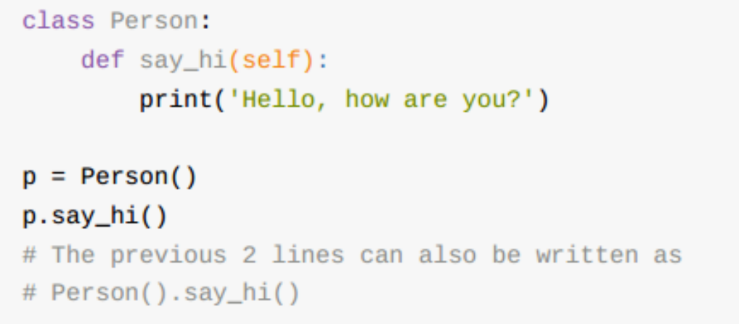
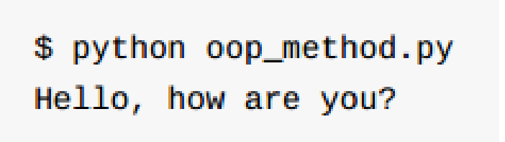
self() method
www.skillslash.com

Slide 10
Init function
Method is called as soon as the object is instantiated.
Useful to do any initialization you want to do with your object.
Difference b/w declaration and initialization
There will be double underscores both at the beginning and at the end.
www.skillslash.com

Slide 11
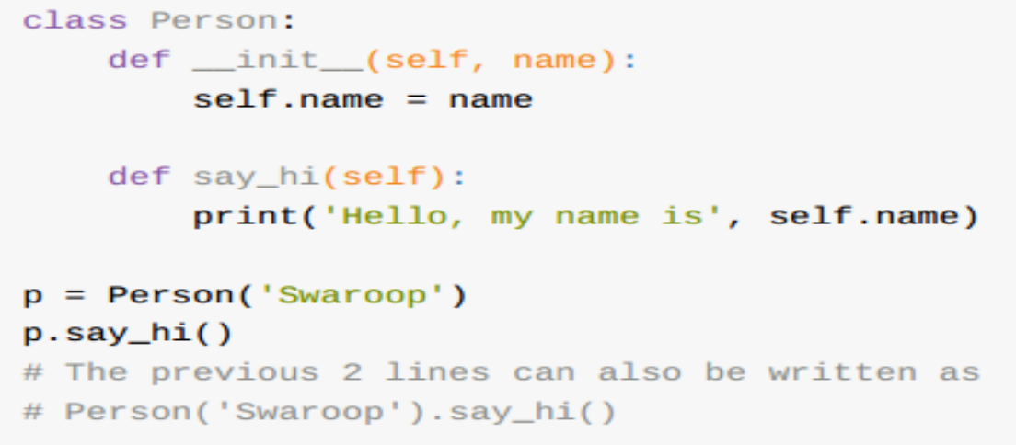
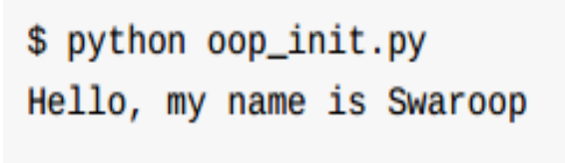
Example
www.skillslash.com

Slide 12
UML Diagrams
Cat
variables
Unified Modeling Diagrams
functions
www.skillslash.com

Slide 13
Class Variables and Object Variables
Class Variables:
They are shared. Can be accessed by all instances of that class. There is only one copy of the class variable. Change in the same by one object results in the change seen by all the objects of the class.
Object Variables:
They are owned by each object/instance of the class. Its not shared so change made by one is not reflected/seen by the other.
E.G: Employee.py
www.skillslash.com

Slide 14
Access Attributes For The Class
• __dict__: Dictionary containing the class's namespace.
• __doc__: Class documentation string or none, if undefined.
• __name__: Class name.
• __module__: Module name in which the class is defined. This attribute is "__main__" in interactive mode.
• __bases__: A possibly empty tuple containing the base classes, in the order of their occurrence in the base class list.
www.skillslash.com

Slide 15
''' The DRY or “Don't Repeat Yourself” principle
is a software development practice aimed at reducing repetition of information. In this lesson, ' \ 'you learned how to' \ ' apply DRY when making comparisons in your Python code. '''

Slide 16
Types of attributes of functions
Arguments
def greet(name, msg):
"""This function greets to
the person with the provided message"""
print("Hello", name + ', ' + msg)
greet("Monica", "Good morning!")

Slide 17
Types of attributes of functions
Python Default Arguments:
Function arguments can have default values in Python.
We can provide a default value to an argument by using the assignment operator (=).
def greet(name, msg="Good morning!"):
"""
This function greets to
the person with the
provided message.
If the message is not provided,
it defaults to "Good
morning!"
"""
print("Hello", name + ', ' + msg)
greet("Kate")
greet("Bruce", "How do you do?")

Slide 18
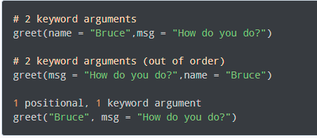
Types of attributes of functions
Python Keyword Arguments:
When we call a function with some values, these values get assigned to the arguments according to their position.
Python allows functions to be called using keyword arguments. When we call functions in this way, the order (position) of the arguments can be changed. Following calls to the above function are all valid and produce the same result.

Slide 19
Recursion
Advantages of Recursion
Recursive functions make the code look clean and elegant.
A complex task can be broken down into simpler sub-problems using recursion.
Sequence generation is easier with recursion than using some nested iteration.
Disadvantages of Recursion
Sometimes the logic behind recursion is hard to follow through.
Recursive calls are expensive (inefficient) as they take up a lot of memory and time.
Recursive functions are hard to debug.

Slide 20
Recursion
def factorial(x): """This is a recursive function to find the factorial of an integer""" if x == 1: return 1 else: return (x * factorial(x-1)) num = 2 print("The factorial of", num, "is", factorial(num))

Slide 21
Recursion
def list_sum(num_List): if len(num_List) == 1: return num_List[0] else: return num_List[0] + list_sum(num_List[1:]) print(list_sum([2, 4, 5, 6, 7]))

Slide 22
Types of attributes of functions
Python Arbitrary Arguments
Sometimes, we do not know in advance the number of arguments that will be passed into a function. Python allows us to handle this kind of situation through function calls with an arbitrary number of arguments.
In the function definition, we use an asterisk (*) before the parameter name to denote this kind of argument
def greet(*names):
"""This function greets all
the person in the names tuple."""
# names is a tuple with arguments
for name in names:
print("Hello", name)
greet("Monica", "Luke", "Steve", "John")

Slide 23
def print_name(name1, name2): """ This function prints the name """ print (name1 + " and " + name2 + " are friends") #calling the function print_name(name2 = 'John',name1 = 'Gary')

Slide 24
Local and global namespace
# var1 is in the global namespace
var1 = 5
def some_func():
# var2 is in the local namespace
var2 = 6
def some_inner_func():
# var3 is in the nested local
# namespace
var3 = 7
Global variable processing:
count = 5
def some_method():
global count
count = count + 1
print(count)
some_method()

Slide 25
Local and global namespace
Scope of local variables
def some_func():
print("Inside some_func")
def some_inner_func():
var = 10
print("Inside inner function, value of var:",var)
some_inner_func()
print("Try printing var from outer function: ",var)
some_func()
Inside some_func
Inside inner function, value of var: 10
Traceback (most recent call last):
File "/home/1eb47bb3eac2fa36d6bfe5d349dfcb84.py", line 8, in
some_func()
File "/home/1eb47bb3eac2fa36d6bfe5d349dfcb84.py", line 7, in some_func
print("Try printing var from outer function: ",var)
NameError: name 'var' is not defined

Slide 26
Lambda Function
Python supports the creation of anonymous functions (i.e. functions that are not bound to a name) at runtime, using a construct called "lambda".
Not exactly the same as lambda in functional programming languages, but it is a very powerful concept that's well integrated into Python and is often used in conjunction with typical functional concepts like filter(), map() and reduce().
www.skillslash.com

Slide 27
Difference
Python supports the creation of anonymous functions (i.e. functions that are not bound to a name) at runtime, using a construct called "lambda".
Not exactly the same as lambda in functional programming languages, but it is a very powerful concept that's well integrated into Python and is often used in conjunction with typical functional concepts like filter(), map() and reduce().
www.skillslash.com

Slide 28
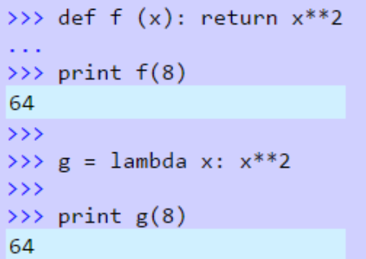
Difference
www.skillslash.com

Slide 29
Filter
The filter() method filters the given sequence with the help of a function that tests each element in the sequence to be true or not.
filter(function, sequence)
Parameters:
function: function that tests if each element of a
sequence true or not.
sequence: sequence which needs to be filtered, it can
be sets, lists, tuples, or containers of any iterators.
Returns:
returns an iterator that is already filtered.
www.skillslash.com

Slide 30
Filter
# Python filter() function example
def filterdata(x):
if x>5:
return x
# Calling function
result = filter(filterdata,(1,2,6))
# Displaying result
print(list(result))
www.skillslash.com

Slide 31
Map
The python map() function is used to return a list of results after applying a given function to each item of an iterable(list, tuple etc.)
www.skillslash.com

Slide 32
Map
# Return double of n
def addition(n):
return n + n
# We double all numbers using map()
numbers = (1, 2, 3, 4)
result = map(addition, numbers)
print(list(result))
www.skillslash.com

Slide 33
Sort
# A function that returns the 'year' value:
def myFunc(e):
return e['year']
cars = [
{'car': 'Ford', 'year': 2005},
{'car': 'Mitsubishi', 'year': 2000},
{'car': 'BMW', 'year': 2019},
{'car': 'VW', 'year': 2011}
]
cars.sort(key=myFunc)
www.skillslash.com

Slide 34
Reduce
Python's reduce() is a function that implements a mathematical technique called folding or reduction. reduce() is useful when you need to apply a function to an iterable and reduce it to a single cumulative value.
www.skillslash.com

Slide 35
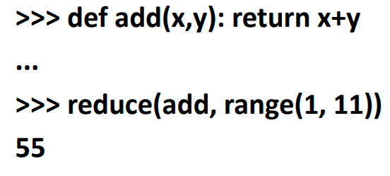
Reduce
www.skillslash.com

Slide 36
Closure concept
# Python program to illustrate # nested functions:
def outerFunction(text):
text = text
def innerFunction():
print(text)
innerFunction()
if __name__ == '__main__':
outerFunction('Hey!')
www.skillslash.com

Slide 37
Closure concepts
# Python program to illustrate # closures
def outerFunction(text):
text = text
def innerFunction():
print(text)
# Note we are returning function
# WITHOUT parenthesis
return innerFunction
if __name__ == '__main__':
myFunction = outerFunction('Hey!')
myFunction()

Slide 38
Iterator
Python type that can be used with a for loop.
Python lists, tuples, dicts and sets are all examples of inbuilt iterators
__iter__ method that is called on initialization of an iterator. This should return an object that has a next method (In python 3 this is changed to __next__).
www.skillslash.com

Slide 39
Iterator
Iterators are objects that allow you to traverse through all the elements of a collection and return one element at a time.

Slide 40
Iterator
# Here is an example of a python inbuilt iterator # value can be anything which can be iterate
iterable_value = skillslash'
iterable_obj = iter(iterable_value)
while True:
try:
# Iterate by calling next
item = next(iterable_obj)
print(item)
except StopIteration:
# exception will happen when iteration will over
break
Notes:
# Here is an example of a python inbuilt iterator
# value can be anything which can be iterate
iterable_value = skillslash'
iterable_obj = iter(iterable_value)
while True:
try:
# Iterate by calling next
item = next(iterable_obj)
print(item)
except StopIteration:
# exception will happen when iteration will over
break

Slide 41
Iterator example
# A simple Python program to demonstrate
# working of iterators using an example type
# that iterates from 10 to given value
Notes:
A simple Python program to demonstrate
# working of iterators using an example type
# that iterates from 10 to given value
# An iterable user defined type
class Test:
# Constructor
def __init__(self, limit):
self.limit = limit
# Creates iterator object
# Called when iteration is initialized
def __iter__(self):
self.x = 10
return self
# To move to next element. In Python 3,
# we should replace next with __next__
def __next__(self):
# Store current value ofx
x = self.x
# Stop iteration if limit is reached
if x > self.limit:
raise StopIteration
# Else increment and return old value
self.x = x + 1;
return x
# Prints numbers from 10 to 15
for i in Test(15):
print(i)
# Prints nothing
for i in Test(5):
print(i)

Slide 42
eval()
The eval() method returns the result evaluated from the expression

Slide 43
#The eval() method returns the result evaluated from the expression
x=1
print(eval("x+1"))
'''
# Perimeter of Square
def calculatePerimeter(l):
return 4*l
# Area of Square
def calculateArea(l):
return l*l
expression = input("Type a function: ")
for l in range(1, 5):
if (expression == 'calculatePerimeter(l)'):
print("If length is ", l, ", Perimeter = ", eval(expression))
elif (expression == 'calculateArea(l)'):
print("If length is ", l, ", Area = ", eval(expression))
else:
print('Wrong Function')
break
'''
Notes:
#The eval() method returns the result evaluated from the expression
x=1
print(eval("x+1"))
'''
# Perimeter of Square
def calculatePerimeter(l):
return 4*l
# Area of Square
def calculateArea(l):
return l*l
expression = input("Type a function: ")
for l in range(1, 5):
if (expression == 'calculatePerimeter(l)'):
print("If length is ", l, ", Perimeter = ", eval(expression))
elif (expression == 'calculateArea(l)'):
print("If length is ", l, ", Area = ", eval(expression))
else:
print('Wrong Function')
break
'''

Slide 44
THANK YOU
www.skillslash.com

